Slide 1
CASB Scrum Workshop 2020
Intro to Agile and Scrum
Kathy Massucci
April 2020

Slide 2
Agile

Slide 3


Slide 4
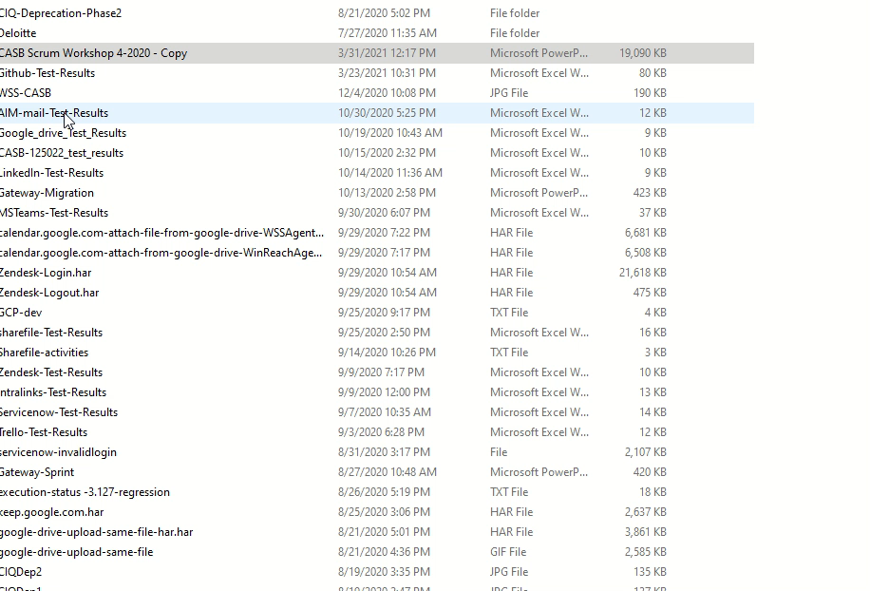

Slide 5


Slide 6


Slide 7
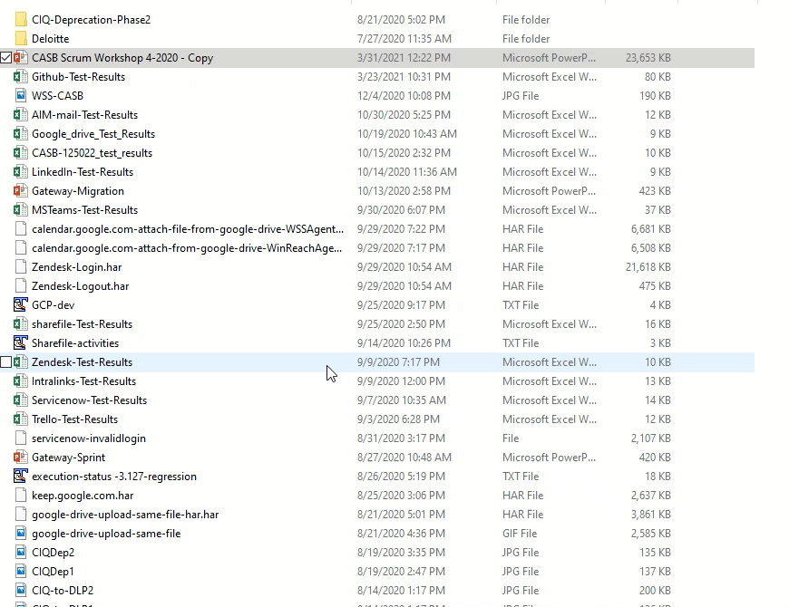

Slide 8
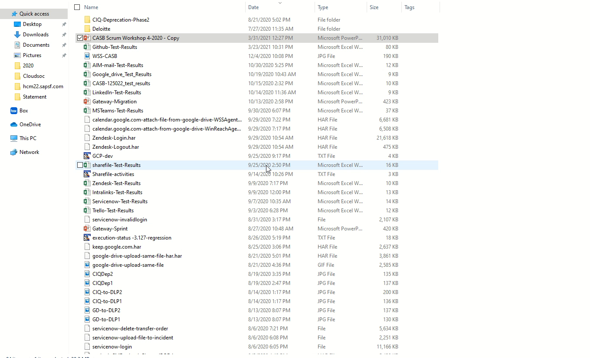

Slide 9
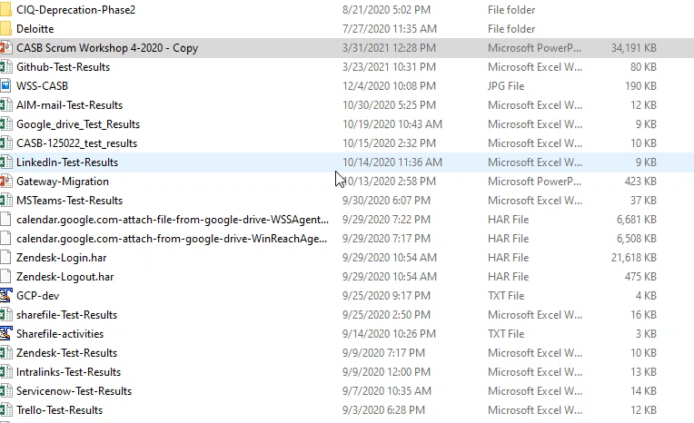

Slide 10
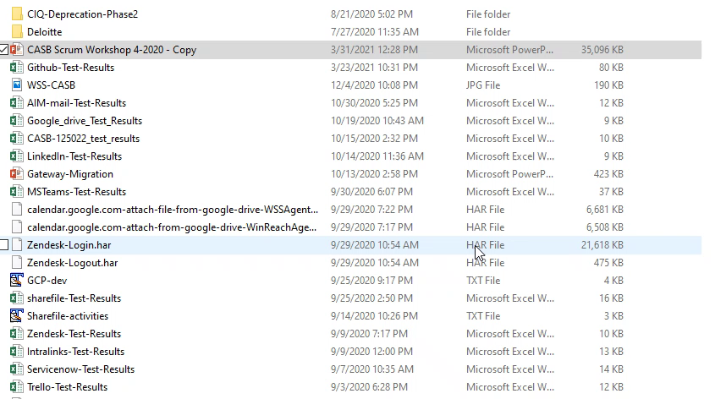

Slide 11

Agile is a mindset – a way to think Scrum is a way to work
ag·ile
adjective
Late Middle English: via French from Latin agilis, from agere ‘do.’
quick and well-coordinated
active; lively
marked by an ability to think quickly; mentally acute or aware

Slide 12
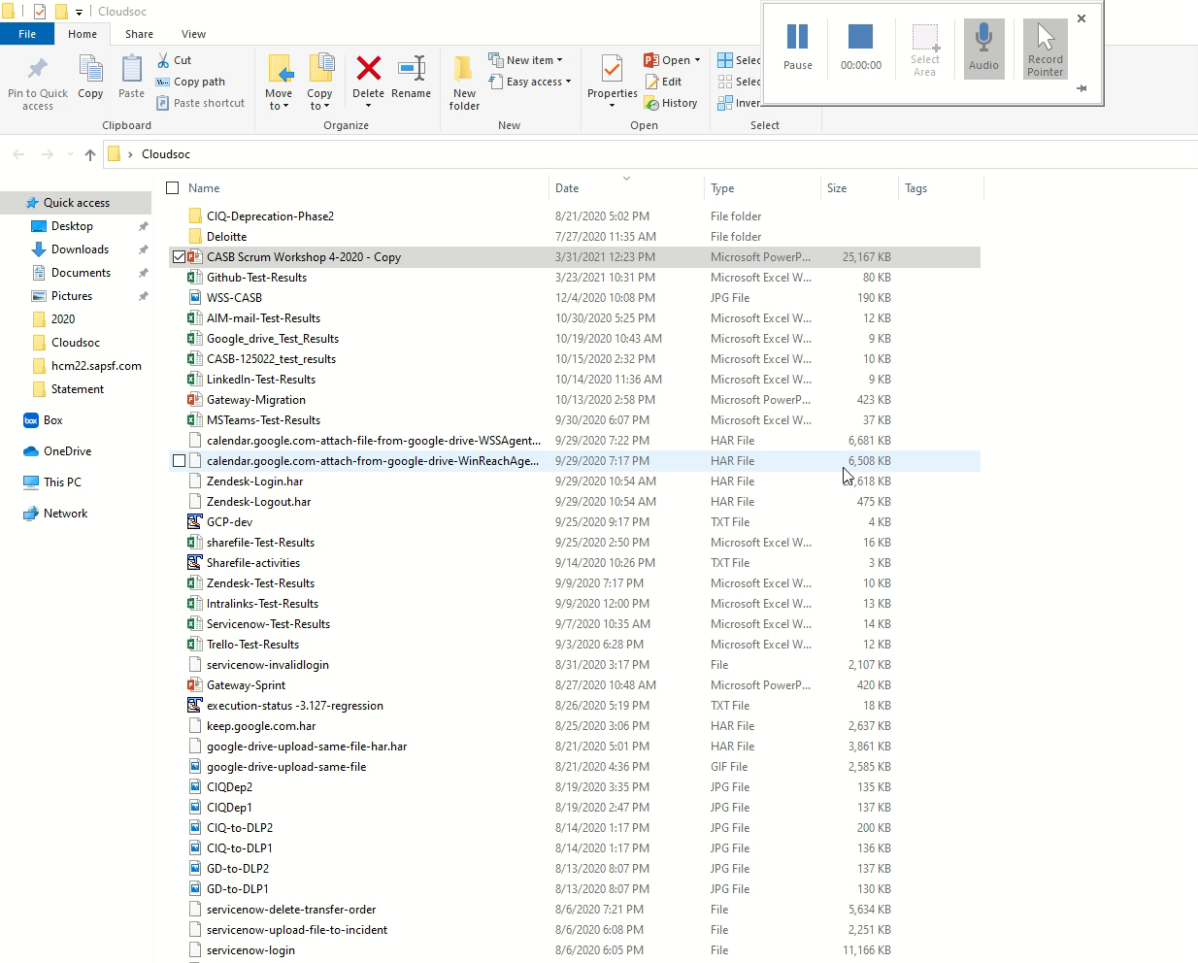

Slide 13
Agile Manifesto – the Origin Story and the 4 Values
“We are uncovering better ways of developing software by doing it and helping others do it.
Through this work we have come to value:
Individuals & interaction
over
Process & tools
Working software
over
Comprehensive documentation
Customer collaboration
over
Contract negotiation
Responding to change
over
Following a plan
That is, while there is value in the items on the right, we value the items on the left more.”

Slide 14
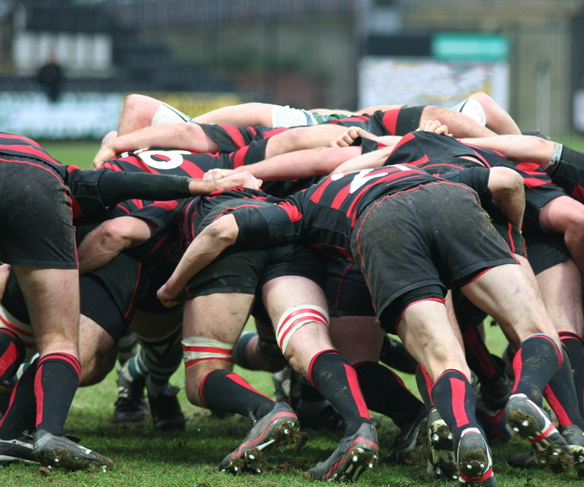
Value 1: Individuals & Interactions

Slide 15
Traditional Development
Agile Development
Developer codes, unit tests, debugs, checks in the code, sends message to QA that they are done
Tester tests code, records problems in defect tracker, tracker sends message to developer
Developer stops what they are doing, resets to what they had previously “finished,” and fixes the defects
Rinse and Repeat
Development Engineer and Test Engineer sit together and work on the code simultaneously… coding, writing test cases, testing pieces of code, reviewing the code, etc.

Slide 16
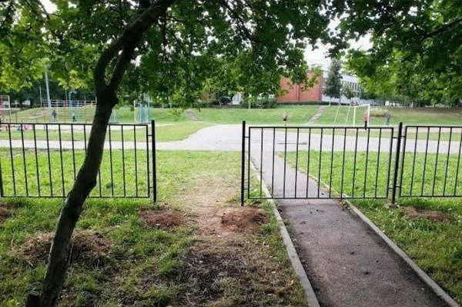
Shared Responsibility – Not “That’s not my job”
Waterfall:
Team members have specialized roles
Dev engineer, QA engineer
Each team member is responsible for just one aspect of the project
Agile:
All team members share the responsibility for all aspects of the project
Every member develops and runs tests
T-shaped skills

Slide 17
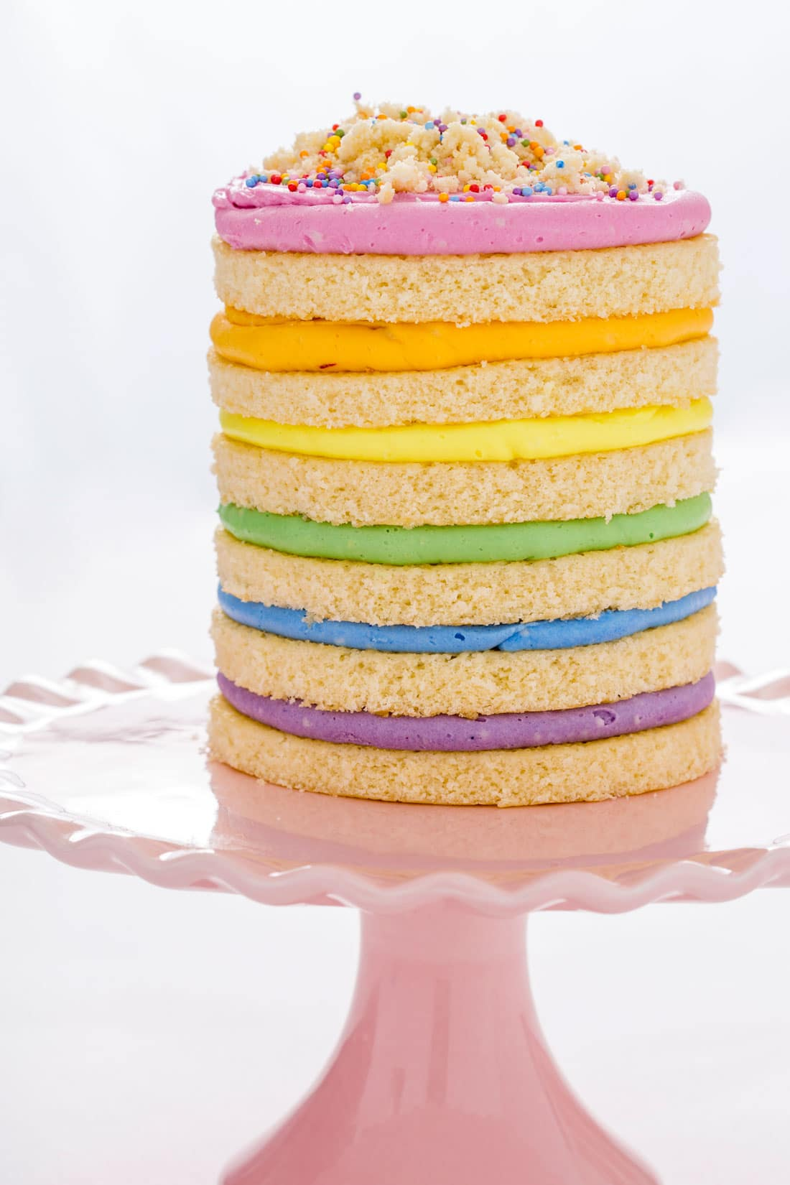
Value 2: Working Software

Slide 18
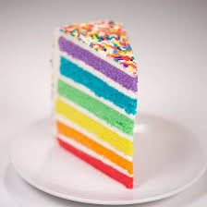
Slice of the cake
Waterfall:
Software functionality is achieved in layers, like a cake. The functionality is not “done” until all layers are complete.
The customer can have no cake until all the layers for the functions have been developed, tested, and completed.
Agile:
The functions of the software (“user stories”) are developed in short development cycles called “sprints”
Each sprint delivers a shippable piece of software: (a “slice of the cake”)
Each slice includes all of the layers necessary to deliver a specific group of user stories.

Slide 19

Value 3: Customer Collaboration
Not exactly the kind of collaboration we’re going to prioritize… instead, think of it as “everyone who consumes my work is my customer”

Slide 20
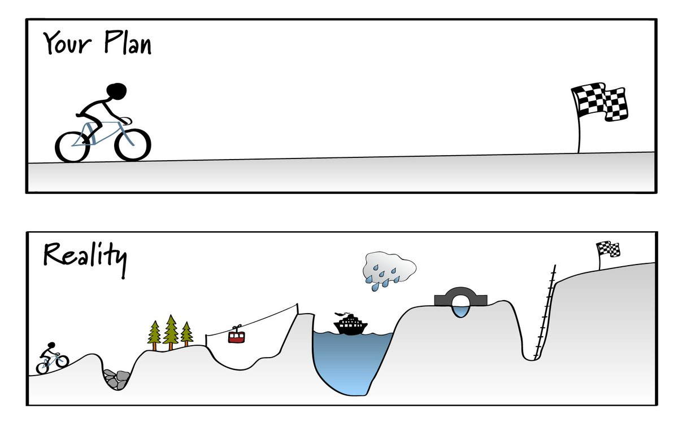
Value 4: Responding to Change

Slide 21

Everyone has a plan… ‘til they get punched in the mouth – Mike Tyson

Slide 22
CONCEPTION
CONCEPTION
ANALYSIS
ANALYSIS
DESIGN
DESIGN
define, take aim, shoot
(hope the target doesn’t move)
DEVELOP
DEVELOP
TEST
TEST
DEPLOY
DEPLOY
WATERFALL APPROACH
AGILE APPROACH

Slide 23
Scrum

Slide 24
Short for “scrummage”
Method for restarting play in rubgy after the ball has gone out of play
Entire team comes together to move ball down the field
Everyone has a specific job
Not all progress is forward progress
All passes are backwards
Progress is not visible until it is over
https://www.youtube.com/watch?v=t8xLtGbIemY

Slide 25
Scrum characteristics
One of the “agile processes”
Self-organizing teams
Product progresses in a series of “sprints”
Requirements are captured as items in a list, or “product backlog”
No specific engineering practices prescribed
Product is designed, coded, and tested during the sprint
A constant duration leads to a better rhythm
Sustainable pace

Slide 26
Scrum components
Scrum roles
Scrum artifacts
Scrum ceremonies

Slide 27
Scrum Roles

Slide 28



The three scrum roles
Roles, not job titles
Product Owners - “what to build” and “why” and “when*”
Key Responsibilities: Product requirements, user stories, PBL grooming
The Rest of the Team - “how to build it” and “how much to build”
Key Responsibilities: Deliver on commitments, develop product increment
Scrum Master “how to build it together”
Key Responsibilities: Scrum coach, clear blockers, protect team
* “When” refers to the schedule for releasing features, which the PO executes via prioritization

Slide 29
Product Owner
the business representative
Not a part-time team member
Defines the work, ensuring the highest value is produced first
Does not define how the work is to be done
Keeper of the product vision
Maintains the product backlog
Continuously sorts and clarifies the upcoming ‘to do list’
Reviews the team’s work
Communicates what constitutes “done-ness”
Reviews sprint demos and tunes the backlog accordingly, to set up the next sprint planning session for success
Not just a PRD writer
PRDs rarely updated; the backlog is always up to date
Close collaborator throughout the process, daily interaction

Slide 30
Scrum master
the servant-leader
Coaches; does not control
Facilitates—unblocks, helps team meet their agreements/commitments
Does not make commitments nor directs their activities
Protects the team from unmanaged change
Unleashes the intelligence and potential of the team
Think: coach of a pro soccer team, not coach of a community team of 4-year-olds
Checking in vs checking up on
Push the team just a little bit
Personal trainer: “do one more rep”
Do not aim so far that the team shuts down
Does not estimate. (Those who do the work should estimate the work.)

Slide 31
Scrum team
the “how” and “how much”
The ones who get it done
Cross-functional, including all skills needed to go from idea to implementation including testing, automation
Typically 5-9 people
Scales through having teams of teams
Self-organizing
Commits to work they’ll implement in a sprint – which user stories, how many
Works with Product Owner to ensure user story and definition-of-done criteria are understood
Maintains close collaboration across their team
Everyone knows “where the ball is” at all times
Reviews and reflects on their own efforts, trying to determine what works best

Slide 32
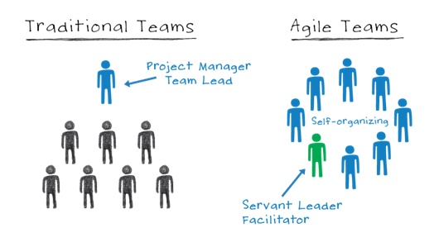
TRADITIONAL TEAMS
SCRUM TEAMS

Slide 33
Scrum Artifacts

Slide 34
Product Backlog
ROADMAP REQUIREMENTS
RESEARCH & POCS
TECHNICAL DEBT
PRIORITY
ETC…
PRODUCT BACKLOG

Slide 35
Sprint Backlog & Sprint Plans
SPRINT BACKLOG, TEAM 1
SPRINT PLAN
TEAM 1 SPRINT 1
TEAM 1 SPRINT 2
TEAM 1 SPRINT 3
SPRINT BACKLOG, TEAM 2
PRIORITY
TEAM 2 SPRINT 1
TEAM 2 SPRINT 2
TEAM 2 SPRINT 3
…
…
PRODUCT BACKLOG

Slide 36
Scrum Ceremonies

Slide 37
The Scrum Ceremonies
SPRINT
RETROSPECTIVE
THE SPRINT
An opportunity for the Scrum team to inspect the experience of the past Sprint and create a plan for improvements to be enacted during the next Sprint.
Sprints are the heart of scrum and have consistent durations throughout a development effort. ISG standardizes on a 3-week sprint cadence.
SCRUM STRUCTURE
(the ceremonies)
SPRINT DEMO
SPRINT PLANNING
In the Sprint Demo, the Scrum Team does an informal demo of the work accomplished in the sprint to the Product Owner to show what backlog items were completed in the sprint.
The work to be performed is planned at the Sprint Planning. The team discusses and estimates the highest priority items in the backlogs and breaks it into tasks.
DAILY SCRUM
BACKLOG GROOMING
A 15-minute time-boxed event for the Scrum team to synchronize on current activities and create a plan for the next 24 hours.
Discussion, breakdown (as needed) and prioritization of the work and requirements that represent the next highest priority.

Slide 38
Backlog Grooming (aka Story Time)
GOAL OF CEREMONY = A SPRINT’S WORTH OF FULLY UNDERSTOOD, SIZED, DECONSTRUCTED REQUIREMENTS
GROOMED AND READY
Do we understand the requirement?
Is enough information provided?
Do we know how to tackle it?
How much work is it?
Do we need research?
How can we break it down?
Are there dependencies?
…
WEEK 1
WEEK 2
WEEK 3
WHOLE SCRUM TEAM
“GROOMED”
EPIC, INITIATIVE, OR LARGE STORY
ALL THE EFFORT NEEDED TO COMPLETE THE LARGER ITEM (INCLUDING SIZING)
ABOUT AN HOUR A WEEK
PRODUCT BACKLOG

Slide 39
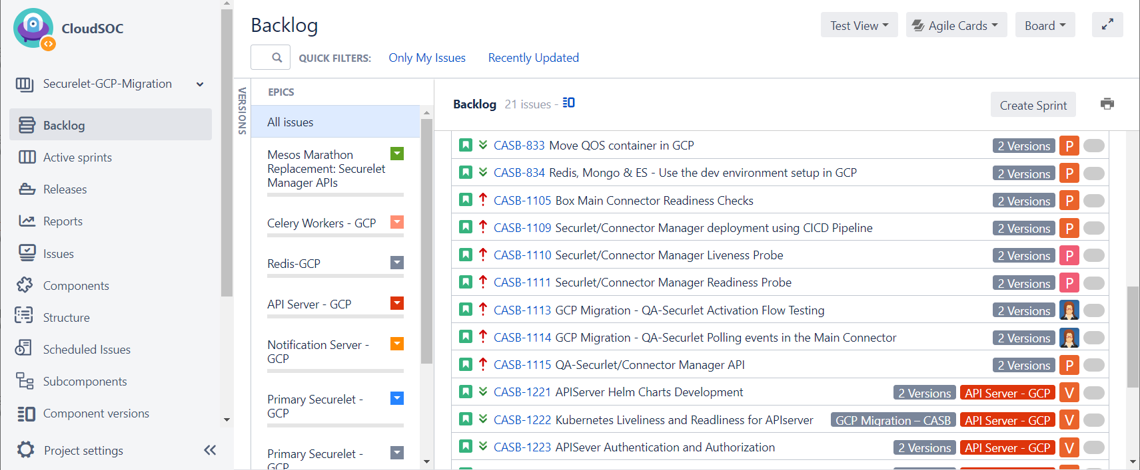
An Actual CASB Backlog

Slide 40
Sprint Planning
IN PROGRESS
TO DO
BLOCKED
DONE
GOAL OF CEREMONY = ALL THE WORK DEFINED AND COMMITTED FOR THE NEXT SPRINT
HIGHEST PRIORITY GROOMED ITEMS
GROOMED AND READY
BROKEN DOWN INTO TASKS (WITH ESTIMATES) FOR THE SPRINT
WHOLE SCRUM TEAM
SPRINT BACKLOG
1.5 – 2 HOURS PER SPRINT
ALL THE TASKS THAT WILL BE WORKED ON IN THE SPRINT, COMMITTED TO BY THE TEAM
= THE SPRINT GOAL

Slide 41
Daily Standup
What blockers can I help address?
Can monitor, stay up to date
Can inform and clarify
Cannot drive the ‘how’
IN PROGRESS
TO DO
BLOCKED
DONE
What did you do yesterday?
What do you plan to do today?
Is anything blocking you?
GOAL = TEAM MAINTAINS CONSISTENT DAILY COLLABORATION TO TRACK PROGRESS AGAINST THE PLAN, ADDRESS RISK AS IT ARISES
SPRINT TASK PROGRESS IS UPDATED BEFORE STANDUP
15 MIN PER DAY

Slide 42
Sprint Demo
IN PROGRESS
TO DO
BLOCKED
DONE
GOAL =
SPRINT GOAL MET
STAKEHOLDERS GLIMPSED THE RESULTS
PO HAS ACCEPTED SPRINT WORK
REFINEMENTS OR ENHANCEMENTS CAPTURED IN BACKLOG
Demonstrate finished work
Work accepted and closed by PO
SPRINT TASK PROGRESS IS UPDATED BEFORE DEMO
1 -2 HOURS ON FINAL DAY OF SPRINT

Slide 43
Sprint Retrospective
GOAL =
CONSIDER THE PRACTICES OF THE PAST SPRINT
SEE WHERE TUNING WOULD HELP
AGREE ON ANY CHANGES/ ADAPTIONS FOR THE UPCOMING SPRINT
REFLECT THE RESULTS IN SPRINT PLANNING
What should we keep doing?
What should we start doing?
What should we stop doing?
~1 HOUR ON FINAL DAY OF SPRINT

Slide 44
Scrum Structure
BUSINESS REQUIREMENTS, BASED ON ROADMAP
DAILY SCRUM
BACKLOG GROOMING
Weekly housekeeping session
15 min, every 24 hrs
THE SPRINT
PRIORITY
3 weeks
SPRINT PLANNING Once, at start of sprint
NO UNMANAGED CHANGES DURING A SPRINT
SPRINT DEMO
& SPRINT RETROSPECTIVE
Once, at end of sprint
POTENTIALLY
SHIPPABLE
PRODUCT
INCREMENT
PRODUCT BACKLOG

Slide 45


Daily Activities in a CASB Sprint (Illustrative)
SPRINT N
Day 1
Day 2
Day 3
Day 4
Day 5
Sprint Planning
(1.5 hours)
Daily Standup (15 min)
Daily Standup (15 min)
Backlog Grooming
1 hour
Daily Standup (15 min)
Scrum time
2 hours/ week
Week 1
Implements stories for current sprint and creates unit tests, automation
TEAM
Refines user stories for Sprint n+1 and creates stories for future sprints
PO
Daily Standup (15 min)
Daily Standup (15 min)
Daily Standup (15 min)
Backlog Grooming 1 hour
Daily Standup (15 min)
Scrum time
2 hours/ week
Week 2
Implements stories for current sprint and creates unit tests, automation
TEAM
Refines user stories for Sprint n+1 and creates stories for future sprints
PO
Daily Standup (15 min)
Daily Standup (15 min)
Daily Standup (15 min)
Backlog Grooming 1 hour
Demo / Review
(1.5 hour)
Scrum time
4 hours/ week
Retrospective
(30-45 min)
Week 3
Implements stories for current sprint and creates unit tests, automation
TEAM
Refines user stories for Sprint n+1 and creates stories for future sprints
PO

Slide 46
Essential Scrum Practices

Slide 47
Sequential vs overlapping development
Requirements
Design
Code
Test
Rather than doing all of one thing at a time...
...Scrum teams do a little of everything all the time

Slide 48
No changes during a sprint
+
+
Team commits to delivering some amount of functionality
The business commits to leave priorities alone during the sprint, allow the team to stay focused
Make the cost of change visible – train everyone to think ahead vs react

Slide 49
Sprint deadlines are sacred
Sprints end when the time box is over.
Missing a deadline is not okay! And missing every time is crushing
Drop scope if necessary – but do it in a planned way
Team, product owner, and scrum master are involved when discussing dropping scope
Dropping scope or dumping to next sprint as a habit is a terrible habit to get into
DOUBLE the size of what you missed, then plan that much less the following sprint
10 hour miss? Next sprint plan 20 hours less work!
When you know what it takes to meet the deadline, and how to make the date, you can focus on sensible scope
Predictablity

Slide 50
Consequences of a change
You have completed the sprint planning meeting.
The team has committed to completing product backlog items A, B, C, and D.
An escalation comes in during the sprint, and the product owner asks the team to work on item E instead of C.
What are the consequences of changing the team’s priorities once the sprint has started?

Slide 51
Absorbing a change
We do not live in an alternate reality where there are no changes and everything goes according to plan
Planning ahead – don’t over-book during a sprint
PO also committing to the sprint during sprint planning
Base your estimates on your actual history, not on what you would LIKE it to be
Only make changes during a scrum ceremony so that entire team is aware
… learn from doing it, and do what works for YOUR scrum team

Slide 52
Defining Done
Planned
Analyzed
Designed
Coded
Code Reviewed
Checked In
Tested
Extend the scope as far as possible
Written down, committed to by team
Team is responsible for ensuring it and checking it
Your sprint plans should account for achieving all DoD requirements
Automated
Regressed

Slide 53
Have rules
Play by those rules
Get a little better each time

Slide 54

Practice = get a little better at it every time

Slide 55
Agile Estimating

Slide 56
The problem with estimating…
…is people. We are terrible at it.
Particularly about making absolute estimates, that are also accurate.

Slide 57


How much does this sailboat cost?
Which sailboat is more expensive?

Slide 58


How long will it take…
….to drive to Chicago?
…to read the last
book in the
Harry Potter
series?

Slide 59
Estimation by analogy:
This looks about the same size as the previous book… maybe a little bigger.
Estimate size of work, then pace:
Book seems to be about 600 pages…
I read about 1 page in 1 ½ mins…
So 40 pages an hour…
600/40 = 15 hours
Distance to Chicago / mph….

Slide 60
Estimate size, derive duration
Size
Calculation
Duration
700
…“units”
Velocity = 20
700/20=35 iterations

Slide 61
Story Points

Slide 62
Why use story points?
Relative estimates – humans are good at these
Great for long-term planning
Law of large numbers – estimates eventually ‘even out’
(Not useful for sprint planning > for that we use tasks/hours)
Product Backlog
As a user, I … | 3
As a user, I … | 5
As a user, I … | 2
As a user, I … | 3
Sprint Backlog
Set up test environment | 12
Automate the feature | 16
Misc Support cases | 12
Split the reporting logs | 8
We’re talking about
these

Slide 63
What are story points?
How long a user story will take (effort)
Allows teams with different skillsets to use the same unit of measurement
Influenced by complexity, uncertainty, risk, volume of work, etc.
Points are unit-less
We use modified Fibonacci: 0, ½, 1, 2, 3, 5, 8, 13, 20, 40, 100
Each number averages out to being roughly 60% larger than the last
Math properties hold
5 + 5 = 10

Slide 64
Advantages to story points
They are additive; time-based estimates might not be
They help avoid problems with unit confusion
It is much easier (especially initially) to do relative sizing
They allow the product owner to prioritize the product backlog
They allow the organization to make longer-term predictions

Slide 65
Relative estimating
40 points
Build the walls
Subflooring
Install flooring
Add a roof
Landscaping
Paint the exterior
Wire everything
Tile the shower
Plumbing
Insulate the walls
Frame the walls
Chimney
Build pool
HVAC
Install front door
Shingle the roof
Carpeting
Install hardwood floors
Hang drywall
3 points
Tile the kitchen backsplash
1 point
Install kitchen faucet

Slide 66
Estimate by analogy
Compare a story to others
This story is like that story, so its estimate is what that story’s estimate was
Don’t use a single gold standard
Triangulate instead
Compare the story being estimated to multiple other stories

Slide 67
Relative estimating
100 points
Dig the foundation
…
Build pool
Subflooring
Wire everything
13 points
Plumbing
HVAC
Chimney
8 points
Insulate the walls
Landscaping
Frame the walls
Hang drywall
Install flooring
5 points
Shingle the roof
Install hardwood floors
Carpeting
Paint the exterior
3 points
Tile the kitchen backsplash
Tile the shower
Install front door
1 point
Install kitchen faucet

Slide 68
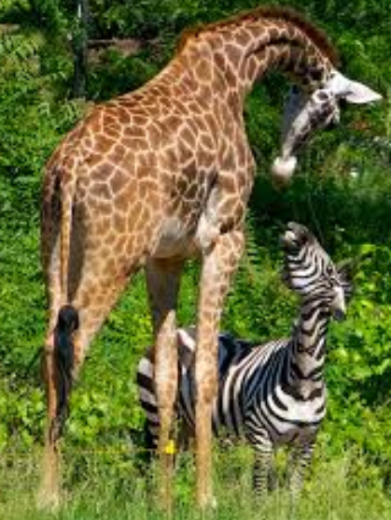
Estimating in Zoo points
Lion
Zebra
Giraffe
Hippopotamus
Bear
Tiger
Kangaroo
Rhinoceros

Slide 69
Why take the time to estimate?
To be able to estimate, you need to learn enough about the story to really understand it
Results in better implementations, fewer mistakes, and so on
The whole team estimating the story means that everyone has had the same conversation and discussed it (ideally) from their own perspectives
The estimates provide a tool for long-term planning
You get better at what you practice

Slide 70
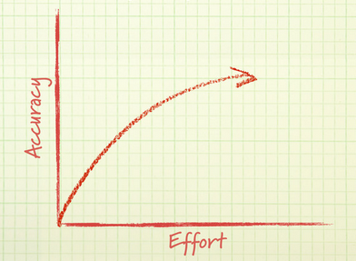
How much effort should go into estimating?
A little effort helps a lot
A lot of effort only helps a little more

Slide 71
Exercise: Story point these items
Read (and understand) a 10-page article on agile software development in a celebrity magazine.
Read (and understand) a 5-page research paper on agile software development in an academic journal.
Recruit, interview, and hire a new member of your team.
Create a 60-minute presentation about agile development for your coworkers.
Your uncle owns a clock store and wants to sell clocks over the internet. Write a basic product backlog covering what his website will need to do.
Wash Rob’s new car.
Read and understand a 150-page book on agile development.
Write an email summary of this class for Yaron.

Slide 72
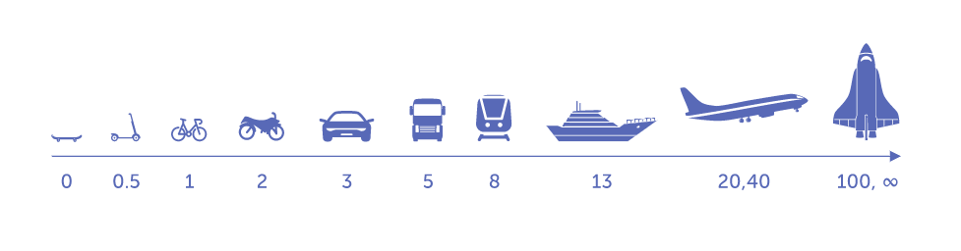
What makes this process agile?
It is more focused on planning than the plan
It is extremely collaborative and requires discussion with the whole team
Done weekly in backlog grooming, it is spread throughout the project (not done only once, at the very beginning)

Slide 73
Velocity and Capacity

Slide 74
Velocity & Capacity
Data used for sprint planning to determine how much work the team is able to take on, in story points
Learned over time. The first-ever sprint is entirely guesswork
(Remember that humans are by nature bad at accurate estimation, so rely on the learning and the data to get better at it over time!)
New team, Sprint 1:
We can do 45 points! No problem! Yay!
…
Sprint 5:
Apparently we cannot seem to do more than 26 points. Okay.

Slide 75
Velocity
Capacity
The total availability of the team, minus the “focus factor”/non-productive hours
Measured in hours
The rate at which the team works
Measured in Story Points
Measured over time
The average number of story points actually achieved across all sprints
Missed stories = missed points
Uses the story points the team added during Backlog Grooming
How many hours each team member is available during the sprint
Minus time for sprint ceremonies
Minus time for non-sprint work commitments
Minus non-productive time (nobody has 8 out of 8 productive hours)
Will differ per person and per sprint
Calculated during sprint planning

Slide 76
Calculating Velocity
Build pool
Subflooring
SPRINT 1 (tackle dependencies)
STORY POINTS ACHIEVED PER SPRINT
21 points
26 points
22 points = 69 points
69 / 3 sprints
Wire everything
SPRINT 2
SPRINT 3
13 points
Plumbing
HVAC
Chimney
Subflooring
Plumbing
Hang drywall
8 points
Insulate the walls
13 points
13 points
8 points
Landscaping
Insulate the walls
Frame the walls
Hang drywall
Wire everything
8 points
Frame the walls
8 points
13 points
Tile the shower
Install flooring
3 points
5 points
Shingle the roof
Install front door
VELOCITY = 23 points
Install hardwood floors
3 points
Install flooring
5 points
Carpeting
Paint the exterior
Put at the top of next sprint
3 points
TEAM VELOCITY
Tile the kitchen backsplash
Tile the shower
SPRINT 1
13 points
+ 8 points = 21 points
SPRINT 2
13 points
+ 13 points = 26 points
SPRINT 3
13 points
8 points
3 points
+ 3 points = 22 points
Install front door
1 point
Install kitchen faucet
PRODUCT BACKLOG

Slide 77
Do not game your Velocity
Velocity is a tool, not a badge of honor. It is for your use, to guide planning your sprints. That is all.
Your team’s velocity in no way compares to the next team’s velocity
Velocity is a measurement, not a target
Velocity does not equal productivity
Velocity is not meant to be improved on! It just IS. Do not get whipped up into a “we gotta get a higher number” foam

Slide 78
Calculating Capacity
Capacity is the actual available time for a team member in hours, adjusted
Factor in “focus”
E.g. 0.6 – 0.8
Remove scrum time
Remove whatever else per the team’s needs
E.g. “Shantanu is the likely responder to an ongoing escalation, so he has only half capacity”
REMAINING CAPACITY TO WORK ON SPRINT BACKLOG ITEMS
Team member | Hours/Day | Days | Capacity
Omar | 8 | 10 | 46
Mike | 8 | 10 | 45
Tomas | 8 | 10 | 46
Jaya | 8 | 9 | 36
PRODUCTIVITY CONSTRAINT
OTHER: (E.G., TIME OFF)
AD HOC/NON-SCRUM ACTIVITIES
40-HR WORK WEEK
SCRUM CEREMONIES

Slide 79
Some estimating tips
Every team’s story point estimates can be different (a 3 to Audit might be a 5 to Detect)
Don’t overthink it
There are no prizes for the best estimating
Don’t bother resizing stories
Unless you’ve sized everything spectacularly ‘off’ then yeah, fix it
If it’s more than an 8, try to break it down before Sprint Planning; it probably needs to be split

Slide 80
Epics, Stories, and Tasks

Slide 81
The Requirements – Epics and Stories
Something a user wants
Short, simple descriptions of a feature told from the perspective of the person who desires the new capability, usually a user or customer of the system
Can be technical stories, written from the perspective of the system itself
Typically follow a simple template:
As a <type of user>, I want <some goal> so that <some reason>.
They strongly shift the focus from writing about features to discussing them
These discussions are more important than whatever text is written
That said, the writing is important for later reference; don’t NOT write things down

Slide 82
Who writes epics and stories?
Anyone can write user stories and ideally every team member does
The PO’s responsibility is to make sure a product backlog of agile user stories exists, but that doesn’t mean that the PO is the one who writes them
Who writes a user story is far less important than who is involved in the discussions of it
The written part of the story is not complete until the team has discussed it

Slide 83
Epics
The biggest building block
Typically provided by the PO or TPO
Captures the high-level business or technical goal
Stories
Small chunks of work
Typically tied to an Epic; can be standalone

Slide 84
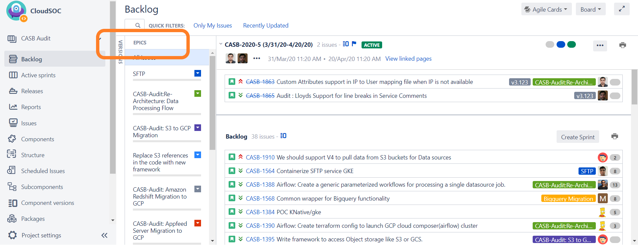
Jira – Viewing Epics and Stories

Slide 85
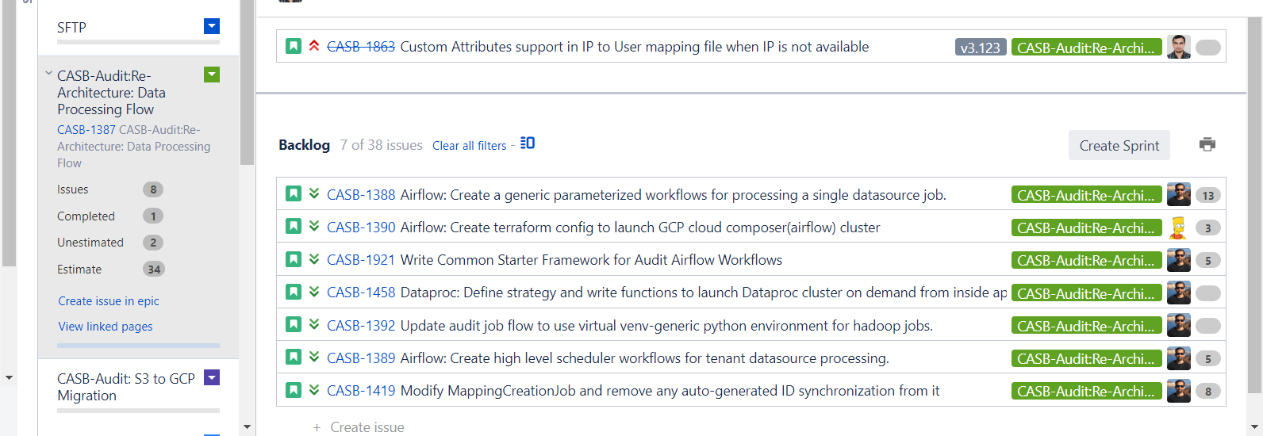
Jira – Viewing Epics and Stories

Slide 86
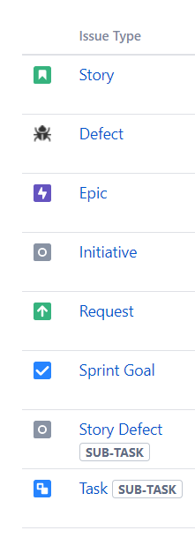
Jira Issue Types
Largest categorization
Broken down from, and tied (linked) to larger issue types

Slide 87
Disaggregation - Epics into Stories, Stories into Tasks
Breaking a big story into smaller stories or tasks
You know how long the smaller tasks take
So disaggregating to something you know lets you estimate something bigger that you don’t know
Sometimes very useful
But disaggregating too far causes problems
Forgotten tasks
Prep the walls
Hang backer board
Hang backer board
Tile the kitchen backsplash
Apply adhesive
Tile the wall
Grout the tile

Slide 88


Disaggregation - Epics into Stories, Stories into Tasks
Hang backer board
Prep the walls
Create a level guideline
Tile the kitchen backsplash
Apply adhesive
That is not level
Tile the wall
Make it actually level
Grout the tile

Slide 89
Why don’t we just stick with requirements documents?
Assumes everything is known up front
Treats learning as a ‘change in scope’
Don’t lend themselves to incremental, iterative delivery

Slide 90
Backlog Grooming

Slide 91
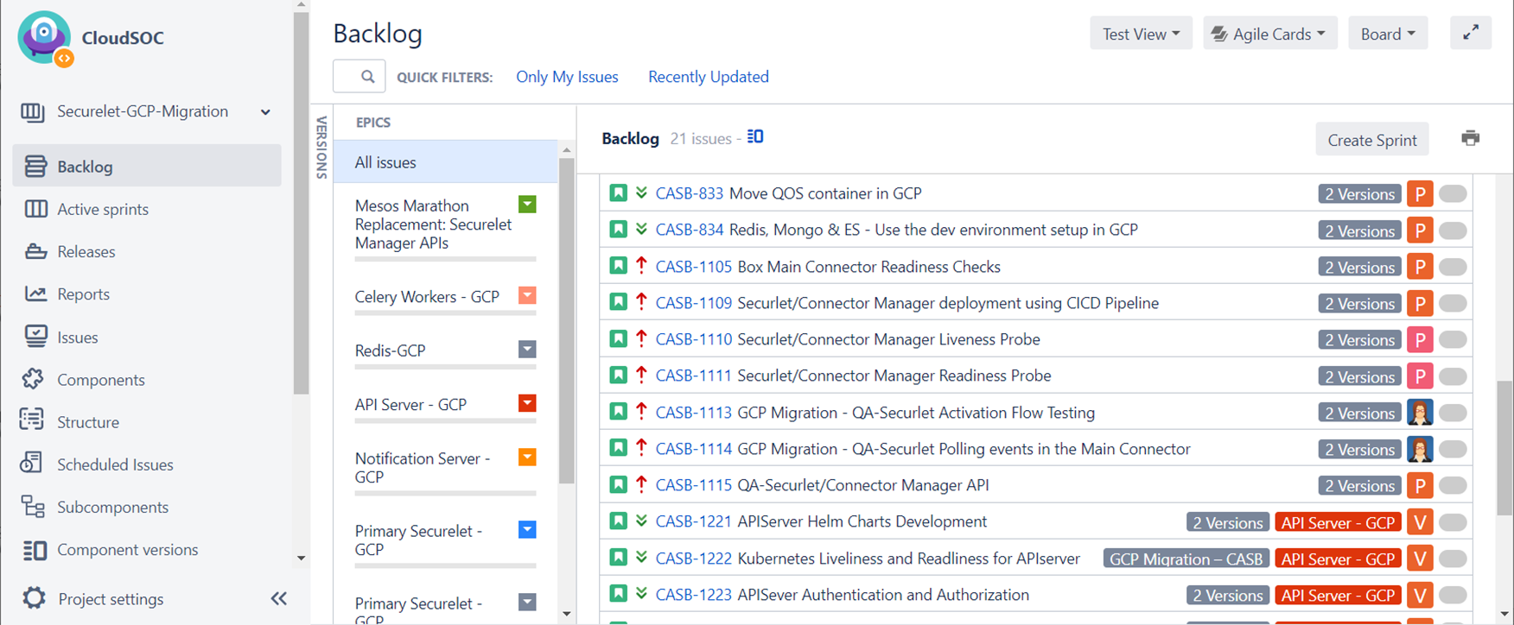
Backlog Grooming Session
Understand it
Do we understand the requirement?
Does it have an adequate description with enough information (in case we can’t get to it until later)?
Does it have Acceptance Criteria?
Do we know how to tackle it?
Size it Estimate it in story points
Does it need expansion or reduction?
Can we tell if there are dependencies?
Do we need research or any other work?
Is it too big as it is? Does it need to be broken down?
Is the data clean?
Is it tied to a Release (Fix Version) or Epic?
Is it labeled with the right tags? (E.g., label, components)
Go through each item starting at the top of the list:
PRODUCT BACKLOG

Slide 92
Tips for backlog grooming
All 3 roles are active during grooming
Team helps to type/create stories based on PO content
PO adds details as needed for reference
SM creates subtasks
Volunteer keeps track of stories to split
Questions for stories
Is the story too big, do we need to break it down?
Is the acceptance criteria sufficient and understood?
Are there early dependencies that need to be identified?
Is more research required? If yes, are the subtasks created?

Slide 93
Sprint Planning

Slide 94
Three levels of planning
RELEASE PLANNING (EPICS)
DAILY PLAN
(TASKS)
DAILY PLAN
(TASKS)
DAILY PLAN
(TASKS)
DAILY PLAN
(TASKS)
DAILY PLAN
(TASKS)
SPRINT PLAN
(STORIES)
DAILY PLAN
(TASKS)
DAILY PLAN
(TASKS)
DAILY PLAN
(TASKS)
DAILY PLAN
(TASKS)
DAILY PLAN
(TASKS)
SPRINT PLAN
(STORIES)
DAILY PLAN
(TASKS)
DAILY PLAN
(TASKS)
DAILY PLAN
(TASKS)
DAILY PLAN
(TASKS)
DAILY PLAN
(TASKS)
SPRINT PLAN
(STORIES)

Slide 95
Sprint Planning Session
INPUTS
PROCESS
OUTPUT
Backlog items that are sized
Team capacity (go around the room and collect the info & write it down)
For each item in the list:
Is it small enough for a sprint? (8 or smaller)
Break it down into tasks
Assign hours to tasks (try to make these about a day or smaller—if you have a 3-day task try to split it into smaller chunks)
Remove those hours from each team member
When it is fully tasked, put it on the sprint
Stop when you have hit your capacity
List of tasks in a sprint
Everyone assigned tasks
Everyone booked to capacity (minus any time set aside for potential issues)
Team member | Capacity
Omar | 46
Mike | 45
Tomas | 46
Jaya | 36
Team member | Capacity
Omar | 46 40 22 8 0
Mike | 45 42 38 20 4
Tomas | 46 40 20 8 1
Jaya | 36 28 18 6 0

Slide 96
A caution
The purpose of the iteration planning meeting is to arrive at a commitment to an iteration goal or set of product backlog items
The purpose of the meeting is not to come up with a list of tasks and hours
The tasks and hour estimates are a tool for determining what we can commit to

Slide 97
Backlog Grooming Vs Spring Planning
Backlog Grooming
Sprint Planning
Cadence: Weekly task (or twice weekly)
Goal: Maintain 1 – 2 sprints worth of estimated, understood, & prioritized stories at the top of the backlog
Tasks:
Discuss the top items in the backlog
Make sure their priority is accurate
Break epics down into stories
Break large stories into smaller stories
Provide estimates (story points)
Cadence: 1x per sprint, on first day
Goal: Committed work for current sprint
Tasks:
Identify team capacity for that sprint
Pull top backlog item in
Break the work into tasks
Determine who will perform the tasks
Assign time estimate in hours to the tasks
Repeat until team capacity is reached
Commit to the workload as a team, then start sprint

Slide 98
Team Agreement

Slide 99
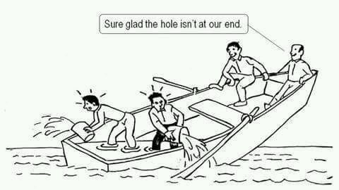
Everyone succeeds, or no one does

Slide 100
Commitment between yourselves as a team
Daily Stand Up
Topics that don’t involve entire group can follow the standup (using the same room/timeslot/meeting login info)
Occurs at 9:15 - 9:30 AM PT M - TH
Have all story/tasks categorized into the correct status bucket prior to the standup
Scrum Master to secure room/dial-in/Webex that doesn't change
No stand up during ceremony days
Meeting will start on time
Sprint Planning/Execution
Team must agree on any scope changes
Sprint availability/capacity information available at beginning of meeting
Planning on alternate Mondays starting in place of stand-up at 9:30 AM PT
PO attends the sprint planning meeting
Subtasks will all be created and estimated during the meeting
Sprint Demo
Only completed stories will be demoed
Demos will be recorded and links posted to team demo page
If technical difficulties preclude recording the demo, in-person demo will take priority & recording will not be available
Held at 1:30 PM PT on last day of sprint
Story Time/Backlog Grooming
Team will meet 1x per sprint (if needed)
Team will keep enough stories for upcoming 1.5 sprints groomed (understood, broken down to 8 or fewer story points, acceptance criteria complete)
Story times are not to be canceled regardless of the deadlines that approach
ST to be held on alternate Mondays, following the stand-up at 9:30 AM PT

Slide 101
Getting ready to launch – a checklist
Before you attend your first sprint meeting
Do you have a team agreement?
Is your backlog prioritized by your PO?
Are your ceremonies all scheduled? (Daily standups, backlog grooming, demo, retro)
Do you have 1-2 sprints’ worth of estimated stories (i.e., story-pointed)?
During your first sprint meeting
Have you broken every story in your first sprint into tasks and hours?
Has your team identified how much capacity each person has, in hours?
Have you taken on only as many stories as your team can handle?
When you have done all of the above: START YOUR ENGINES

Slide 102
Thank you!

Slide 103

Chicken & Pig
Product owner, chicken, owns the strategy – the what, why, when
Agile team, pig, owns the tactics – the how
Notes:
Image:
Chicken and Pig tattoo
by clearwater-art
Designs & Interfaces / Tattoo Design©2008-2014 clearwater-art
http://clearwater-art.deviantart.com/art/Chicken-and-Pig-tattoo-91525416

Slide 104
3 C’s of a well-constructed story
CARD
Stories are ideally sized to fit on one side of an index card
CONVERSATION
Details about the story emerge through conversations between the team and the product owner
CONFIRMATION
Acceptance tests confirm that a story was written correctly

Slide 105
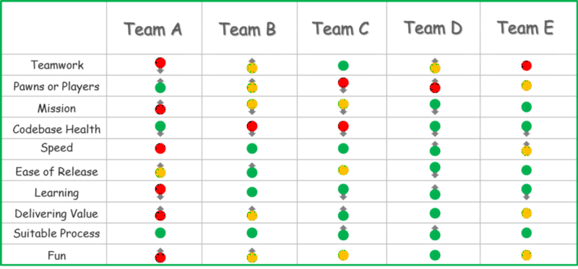
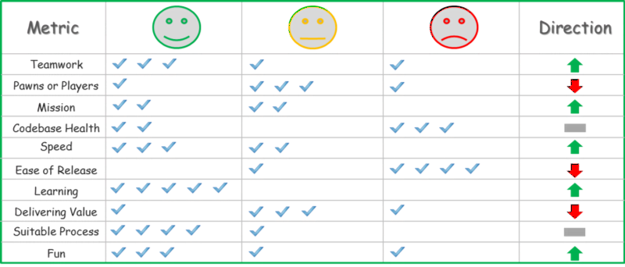

Slide 106
BLRAutomationBlockUploadFileEOE

